Slide 1
Who Am I ?

Slide 2


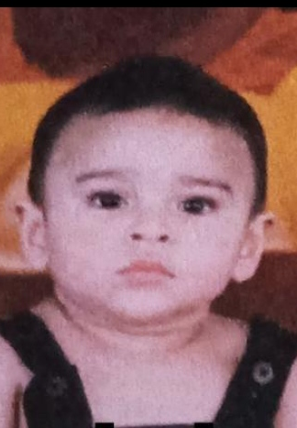
Introduction
My name is Ahmer Habib Khan and I recently turned on 18 on 17th August this year. I was born in Karachi and have been residing here ever since. I am the oldest sibling in my family out of a total of 3 including me, rest being a brother who is the middle one and then my sister who is the youngest. I live with total of 6 people, two of my younger siblings, my parents and my grandparents. All of these members are what make my family complete.

Slide 3



Education
When it comes to education, I have always been a beaconite and been studying in Beaconhouse School System since I was about 3. From pre-nursery till grade 8 I studied there and I can say that it has been a major part of my childhood by now. After grade 8 I did my O Levels privately and succeeded in getting desired grades. I completed my A Levels from Highbrow College. I was initially opting for Medicine but due to the uncertainty, hardships and it being really time-intensive I prepared for IBA’s entrance test simultaneously with MDCAT. My family already has a background in business and business having a much more secure and certain future I switched my fields to BBA from Medical as soon as I got accepted and cleared my entrance test for IBA. I am currently a freshman at IBA and enrolled in my first semester and am having a great experience.
I have learnt some new skills which I didn’t have previously which include Excel and Github while enhanced the ones I already had like using MS Word or my keyboarding.

Slide 4

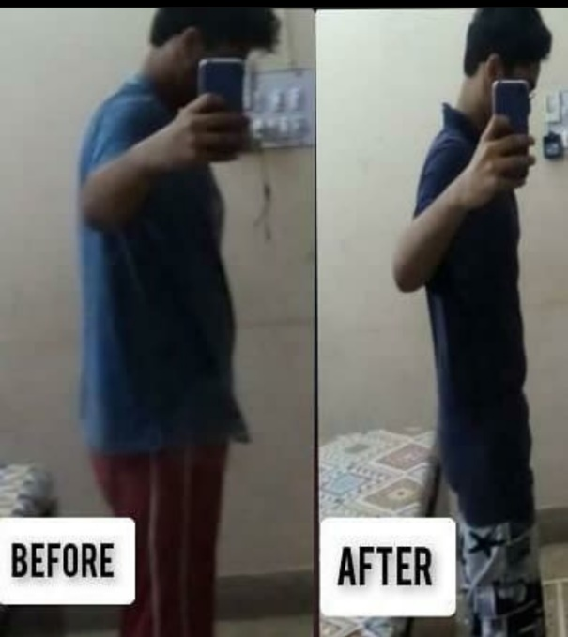
Lifestyle/Accomplishments
When it comes to lifestyle or personality I think if someone meets me it won’t take that long for them to realize that I am an introverted shy person. I am usually shy and introverted but my closest friends who know me for a long time or really well would say otherwise. Some might even say that I talk a lot and am an open book. As a consequence of me being an introverted person, even though I don’t have tons of friends in person, I do have around 20 or so online friends whom I met this year and have grown closer to than anyone else and I would even go as far as saying that I consider them a second family or a part of me of whom I am very grateful for.
About accomplishments, I think my biggest accomplishment would be my weight loss journey in 2020. I lost around 40 kgs or 12 inches from my waist and went from around 110-70 kgs and 42- 30 inches. I had always considered it nearly impossible or something I am incapable of doing but I managed to do it in 2020 after utilizing all the time that I had and working on my 2020’s New Year Resolution with full determination and strong will. This accomplishment is something that always makes me proud of myself and realize that no matter what it is, if one has the will you can always pull it off by staying steadfast.

Slide 5
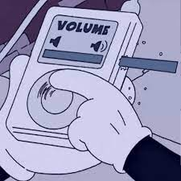
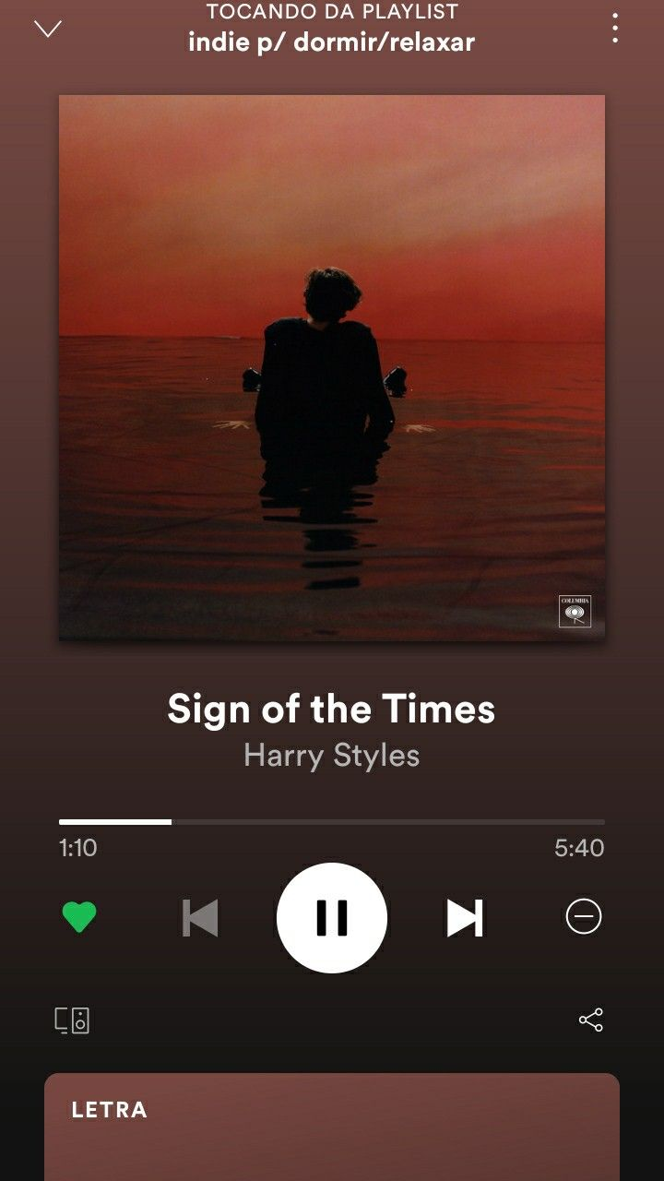

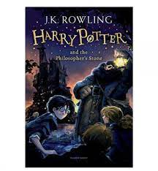

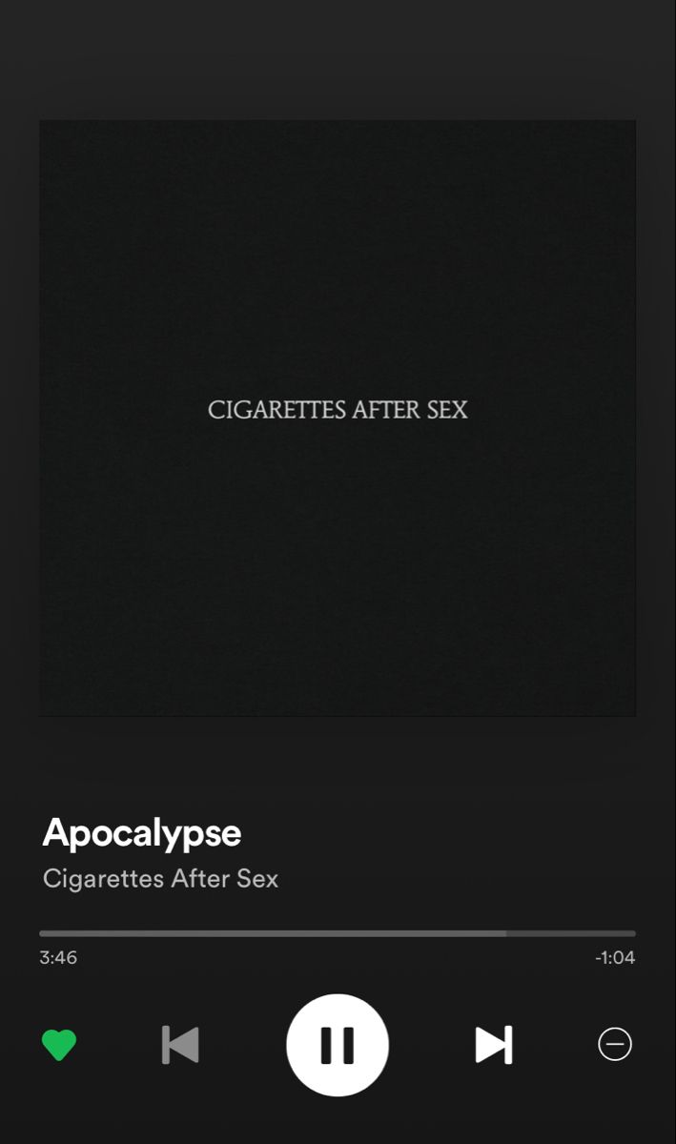
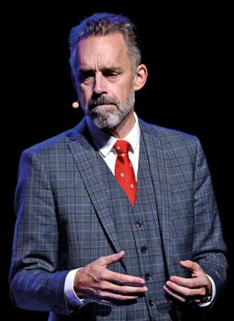
Hobbies/Talents
When it comes to hobbies I think music and watching movies/shows are by biggest hobbies especially music which has more or less become an integral part of my daily life by now. There is a lot to say about my how music and movies/shows comfort me so therefore I have covered them in the next slides. I also happen to be a reader. Even though I haven't read too much I really am hoping to read more books soon, an interest that sparked by watching videos of Jordan B Peterson .who also happens to be among my favorite speakers, and his love for reading. My favorite books as of now are probably the entire Harry Potter franchise and Crime And Punishment by the classic author Fyodor Dostoevsky.
As far as talent is concerned I think I am a very creative person. I discovered my ability to write songs or poems last year which I worked on more this year and have written around 8 poems/songs relating to my own personal experiences in order to cope with them.

Slide 6

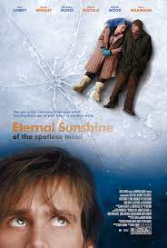

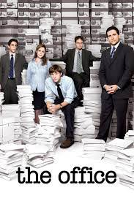
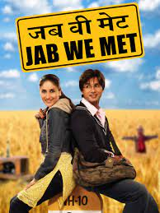
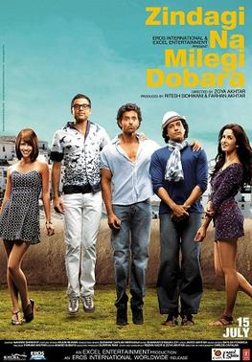

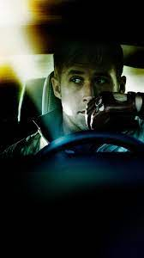
Movies and Shows
Watching movies and shows have always been a source of comfort for me. I love watching movies of any genre as they take me to a world that is not real. Movies such as Eternal Sunshine Of The Spotless Mind, Perks Of Being A Wallflower, Fight Club, Drive etc have always seemed relatable to me to some extent especially the character of Charlie from Perks Of Being A Wallflower who portrays my personality and is therefore someone who I relate a lot with. Some honourable mentions I would like to add are Kal Ho Na Ho, Zindagi Na Milegi Dobara and Jab We Met which teach us a lesson to focus on the happier parts of our life and to be grateful.
When it comes to TV shows, The Office is my favorite TV show because I am assured that whenever I am down or feeling low that show can always make me laugh and feel better. Each character of the show feels like home to me and characters who I feel very close and attached to.
Therefore movies and tv shows are a major part of my life and of my daily routine.

Slide 7
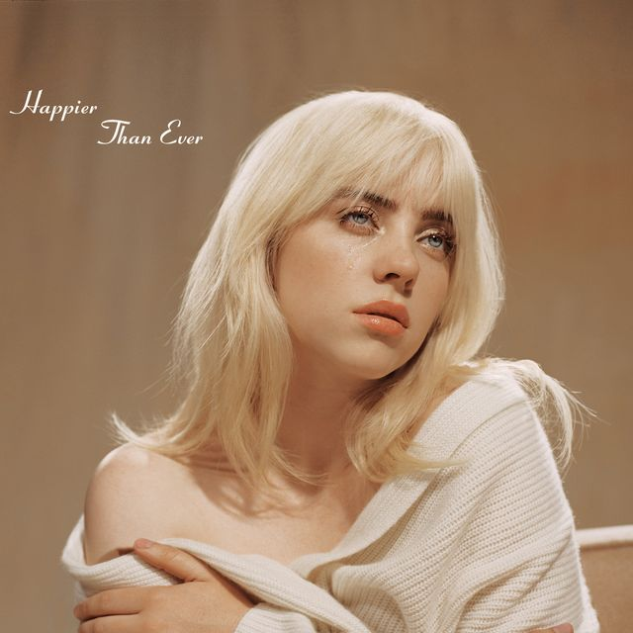

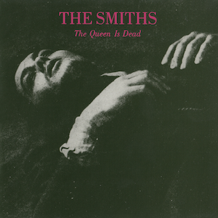

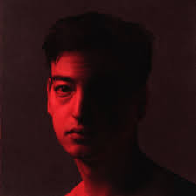

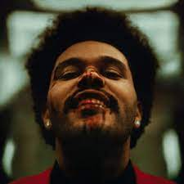
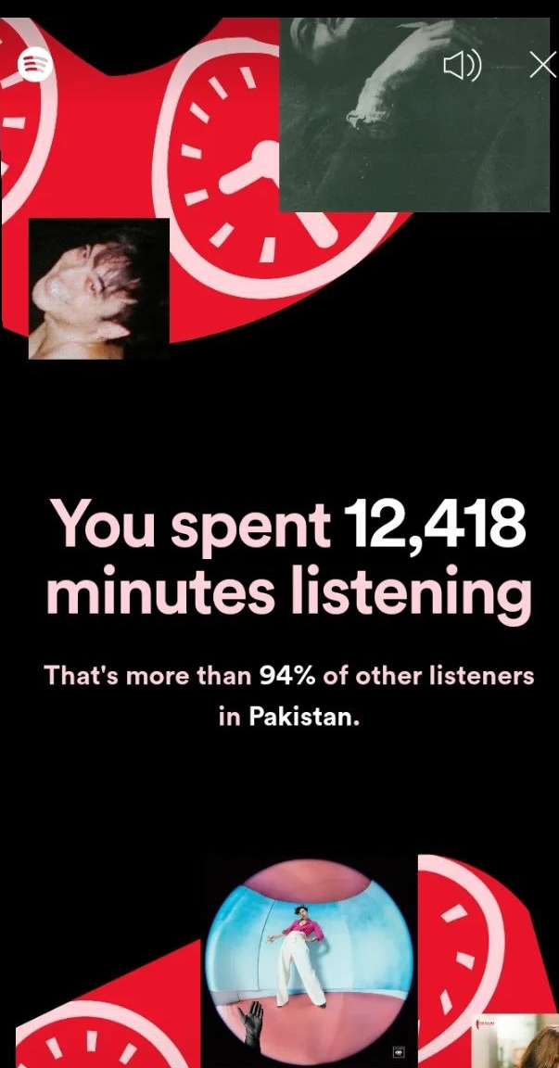
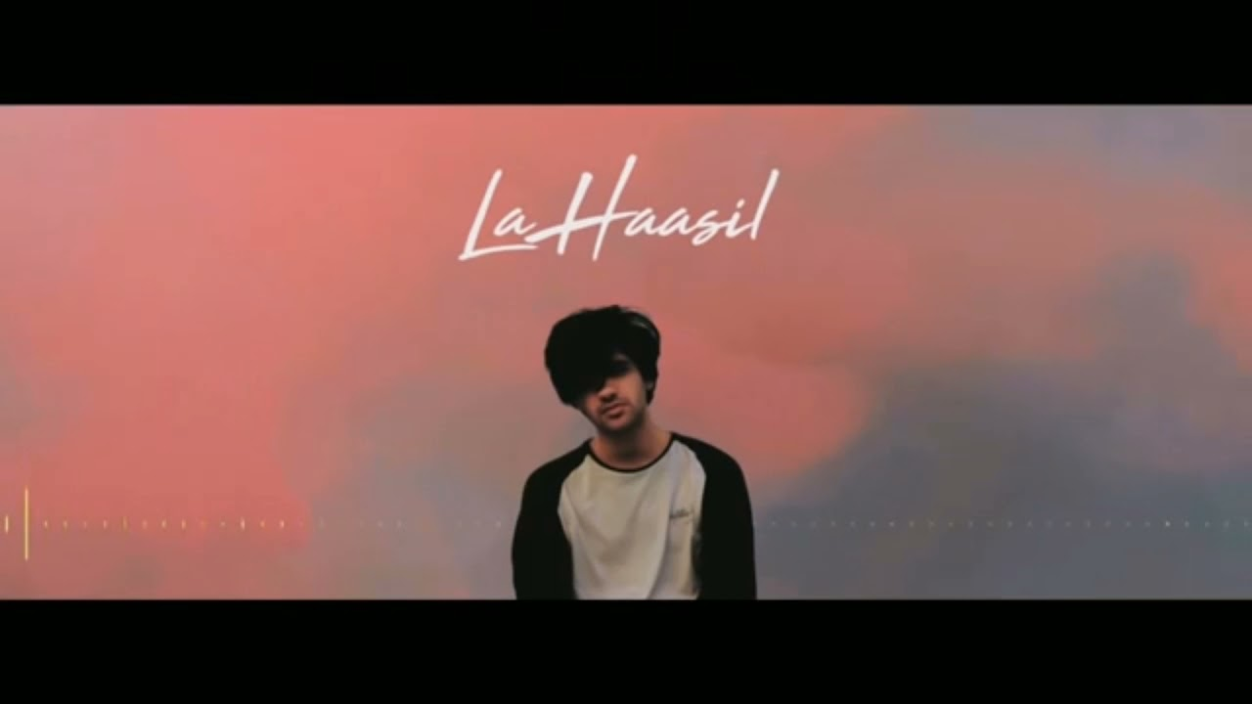
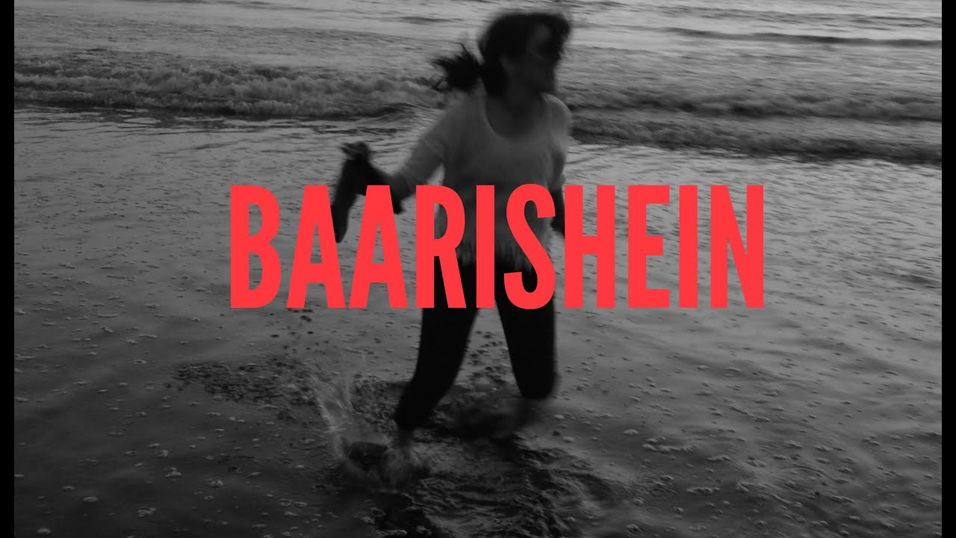


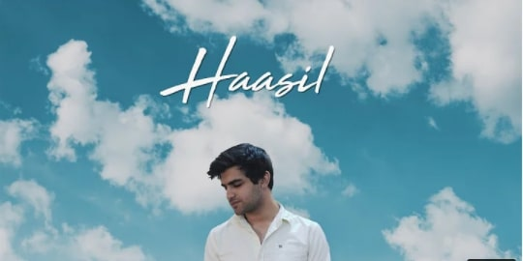
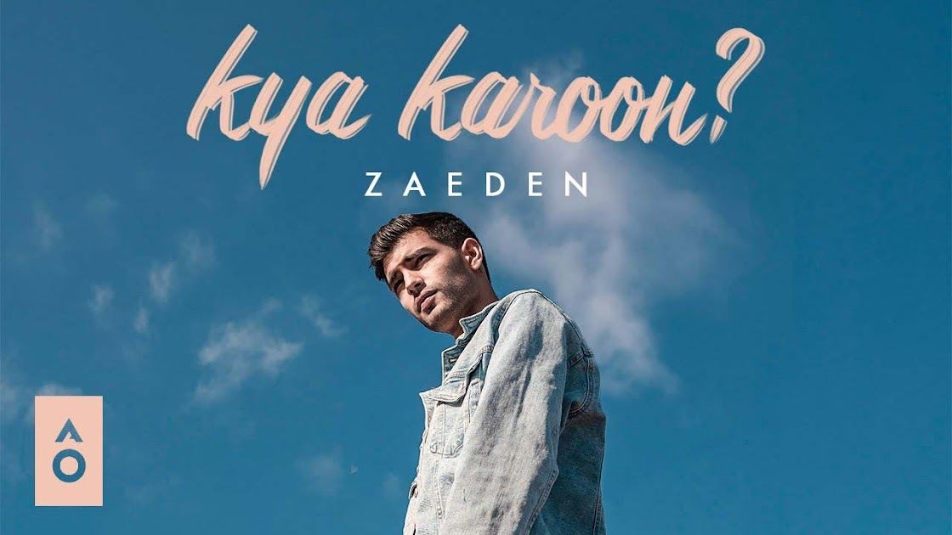
Music
As mentioned before music has become a really important part of my life by now. Whether I am happy, sad, heartbroken or any other thing, music always acts as an escape for me personally. From feeling like a heartbreaker by listening to The Weeknd to feeling like the most heartbroken person by listening to singers like Joji, XXXTENTACION, Billie Eilish, Olivia Rodrigo etc ,music always makes me feel like I am not the only going through these feelings. One Direction has always been a band that I have loved and admired , with songs like Through The Dark I felt like they are talking to me and comforting me.
As someone who is a hopeless romantic I am in love with the band Cigarettes After Sex for their melancholic love songs. Apart from that songs like Moon song from movie Her and There Is A Light That Never Goes Out more commonly known for the famous line" To die by your side is such a heavenly way to die" by The Smiths always make me feel at home.
Indie or slow desi music by artists like Anuv Jain,Zaeden and inspiring pieces of music such as Haasil by Sunny Khan Durrani or the entire album of movie Rockstaer also provide me with an immense amount of ease and comfort.
To conclude this I would like to also share about my favorite album Fine Line from Harry Styles. The album takes one through range of emotions from feeling of love to emotional despair. The album concludes with the line "we'll be alright" assuring us that no matter what one is going through it will all be fine at the end and it is all temporary.
Music always making my feelings valid and bringing sort of peace in me is why it has become such an integral part of my life by now. So much so that my Spotify Wrapped showed that I listened to Spotify for 12,418 minutes which was more than 94% than the country.

Slide 8
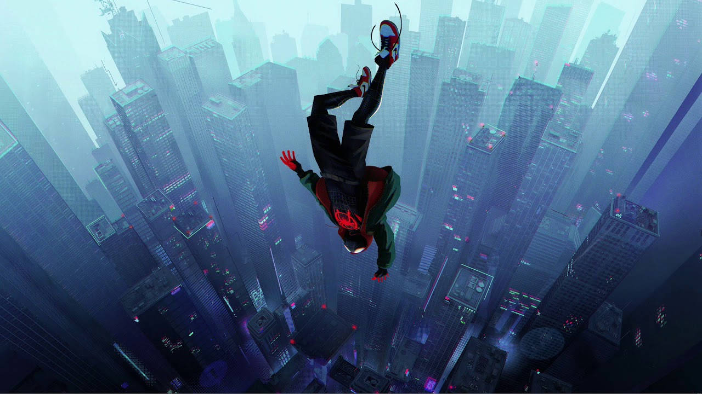
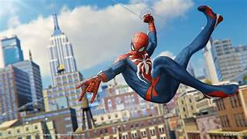


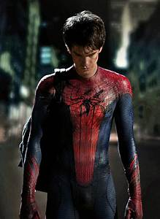
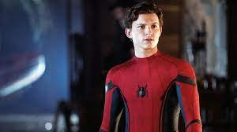
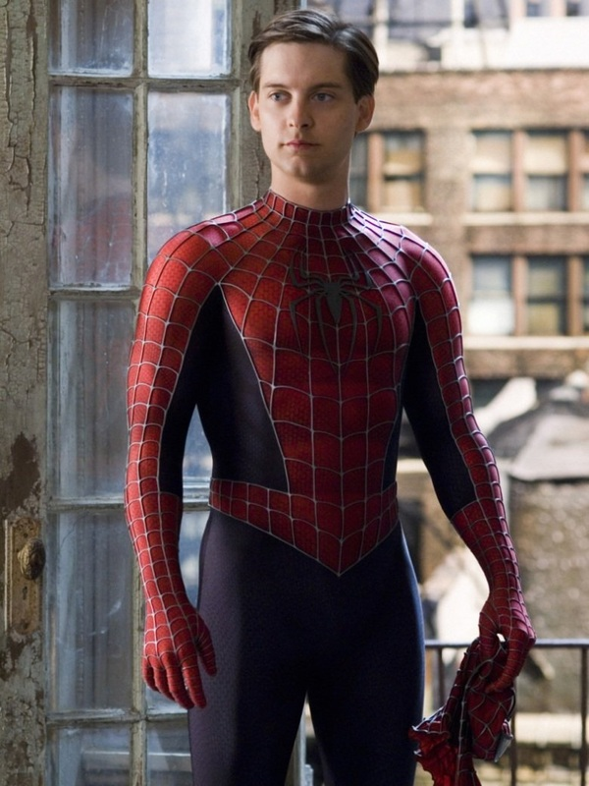
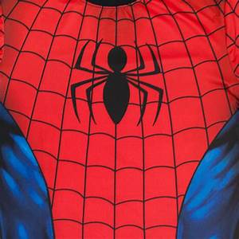
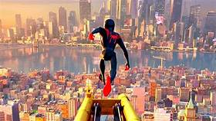
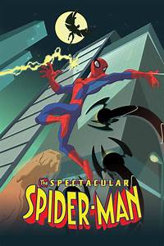
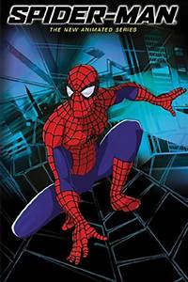

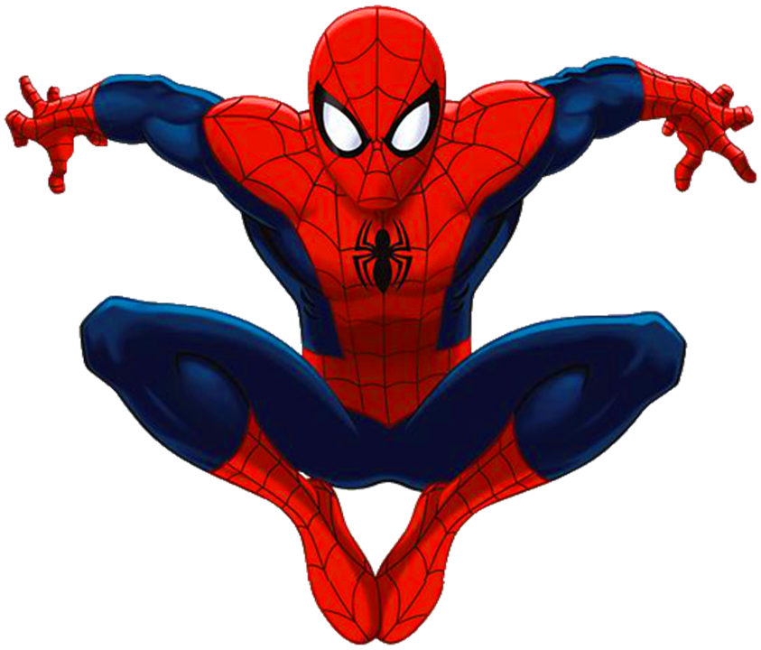
Growing up as a Spiderman fan
Throughout my years of childhood, a character for whom my love kept increasing with time was Spider-Man. I grew up watching the Spider-Man trilogy of Tobey Maguire and have seen the second installment countless times and still am never able to get enough of it. From cartoon series to movies , I have always loved and admired the character of Spider-man because he always, to me, is a beacon of hope. I even spent money to buy DLC for the Spider-Man game on PS4 and completed the whole game more than twice because I am never able to get enough of the character and his web-swinging. Spider-Man always assures people that despite of the flaws this world has one should never stop giving their best and always have hope for betterment in the future.
Unlike many other superheroes, Spider-Man is someone who fights small criminals who would commit thefts etc to an alien or an extra-terrestrial being. He does not have any sort of ego and his goal only is to use his power for the good following the famous quote of his Uncle Ben " With great power, comes great responsibility."
Spider-Man has always been among my comfort characters, a favorite superhero and a major part of my childhood because of telling people that there is always some good left in this world.

Slide 9

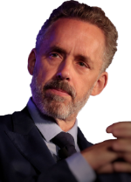
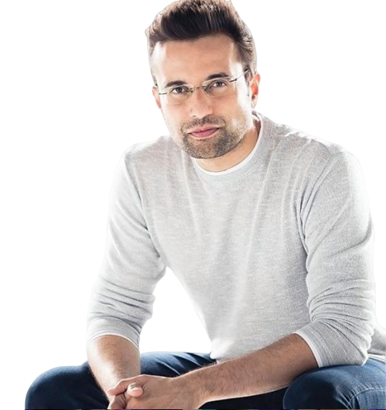
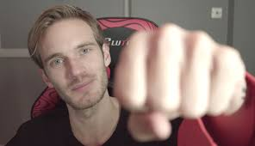
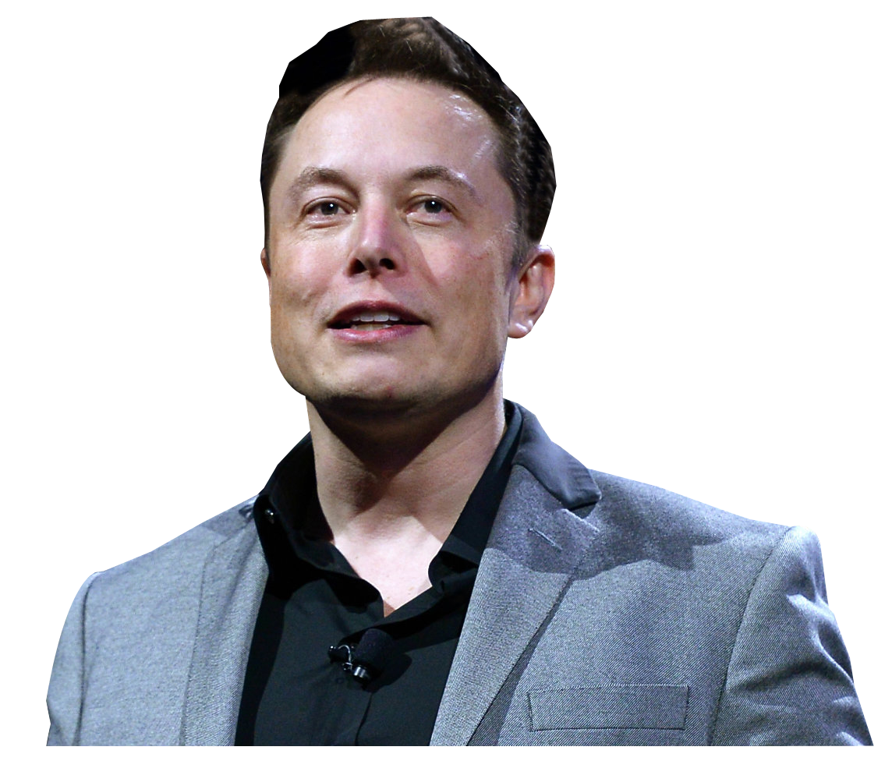
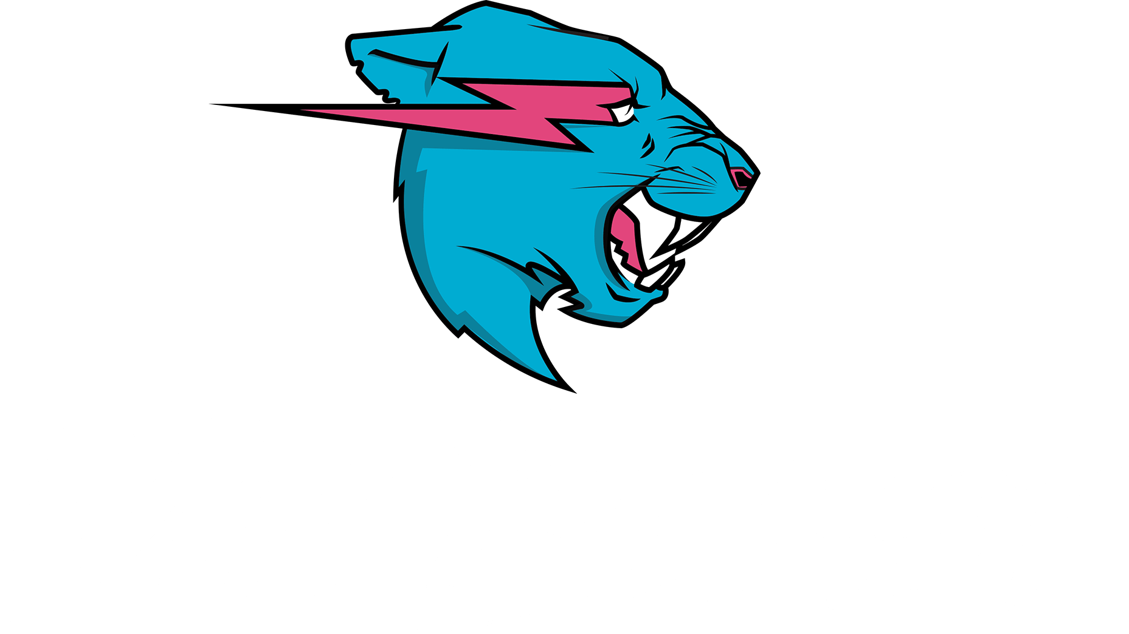
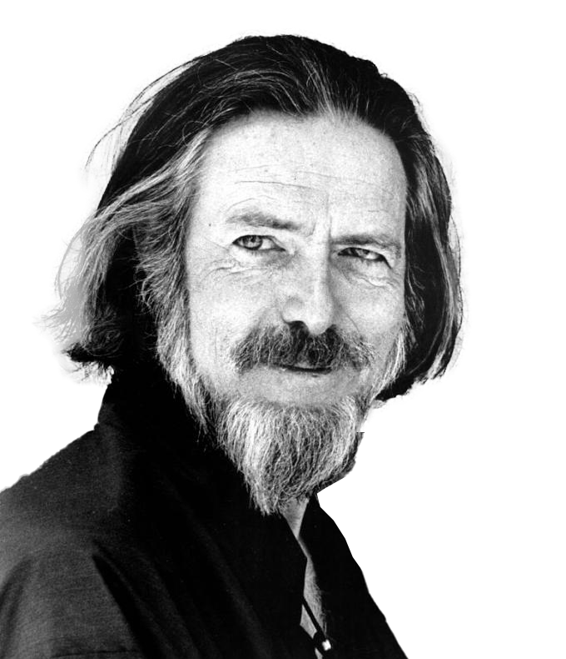


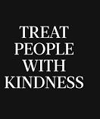
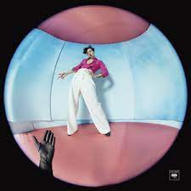
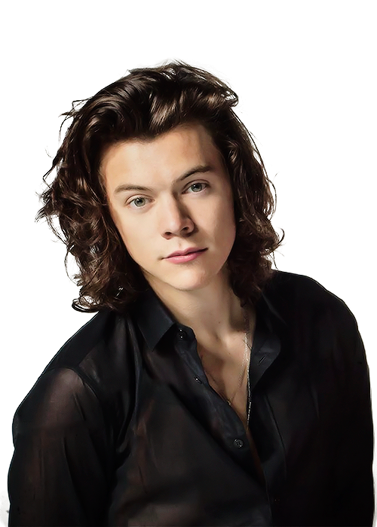
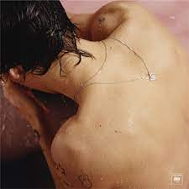

Favorite Personalities
When I talk about favorite personalities what I really mean by that are people who inspire me, help me in some ways or people to whom I generally look upto.
When it comes to favorite personalities , I think for me personally, motivational speakers are a big part of it. Sandeep Maheshwari being my oldest and probably favorite speaker and apart from him speakers like Alan Watts, Sadhguru ,Jordan Peterson, Russel Brand etc almost provide me with some sort of clarity in my mind and have been a source of guidance since about last 3-4 years. Searching up their videos for something that I am struggling with has become a norm for me by now. I do aspire to become as content as they are someday in future.
Elon Musk who has become a global sensation by now is also among my inspirations because of how much dedication he has to his work and how he always tries to give his best . By introducing electric cars etc and so much more he is trying to use his knowledge for the common good.
Using their source of money for the common good reminds me of Mr Beast too who has become very well known by now just in the span of 2-3 years. Using his money for donations, charity and random acts of philanthropy he spreads kindness and a message to help each other.
Talking about Mr. Beast brings me to my favorite youtuber who is none other than Pewdiepie. Even though I have known him for a little less than a decade, my love for him as not just a youtuber but also a person has immensely grown over past few years. There used to be days when his videos were the only thing that I would be looking upto each day. Maybe this sounds kind of cliché but I would even go as far as saying I kind of see him like an older brother who I really look upto. His humility despite being the largest Youtuber( ran by a person), his book reading habit, his wisdom, his interaction with fans and how he chose to do what he loves instead of what was the norm is what makes me love him as a person.
Last but not the least and my favorite personality is definitely Harry Styles. His songs have helped me a lot and apart from the singer he is an incredible human being who always inspires me to be kind to others. His logo "Treat People With Kindness" speaks for itself. Every reporter, celebrity, fan or anyone who has ever interacted with him has nothing but appreciation for him . His concerts are filled with positive and vibes of kindness and I would love to attend one or meet him in person atleast someday in my life.

Slide 10
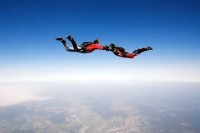
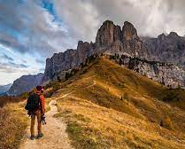
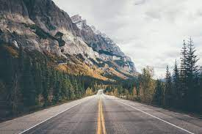
Goals
My main goal has always been to be content with where I am and to try to live life to the fullest which may sound cliché but I really hope I am able to live up to it. I have a bucket list of tasks that I want to do which include stuff like road trips, sky diving etc. Apart from personal satisfaction a goal of mine is also to do atleast one thing for the welfare of society, be it donating something, starting an organization or solving a large scale problem. Even though these ambitions might sound a bit childish they still are ambitions and seeing people like Elon Musk I truly believe that they are possible to achieve if one puts in the effort.

Slide 11
Conclusion
I think the stuff covered in slides is more or less an introduction to me. Even though it is not all I think it kind of pretty well sums up and gives you an idea of the kind of person I am and what I aim to achieve in future.
- By Ahmer Habib Khan

